Slide 1


ENGLISH LEVEL B1 - II
Lesson 04
TALKING ABOUT YOUR HOBBIES
Notes:
Teacher’s Notes:
Explain the lesson goal: learning words and sentences related to hospitals.
Ask students: Have you ever been to a hospital? Why?

Slide 2
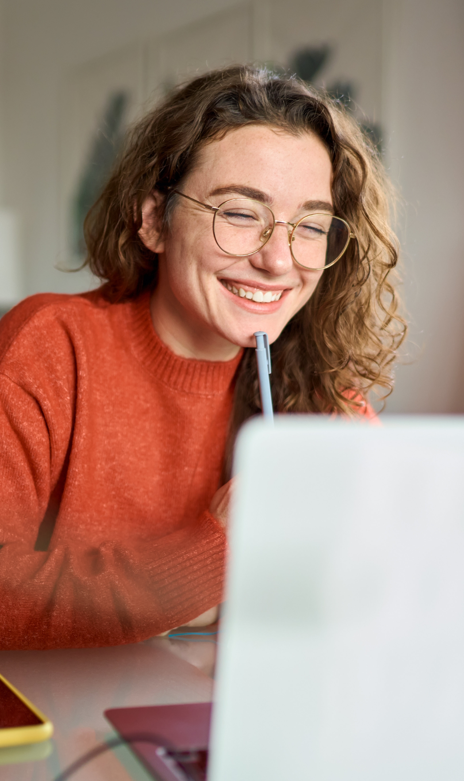
01
Students will be able to talk about their hobbies using relevant vocabulary, expressions, and grammatical structures
ENGLISH LEVEL B1 - II

Slide 3
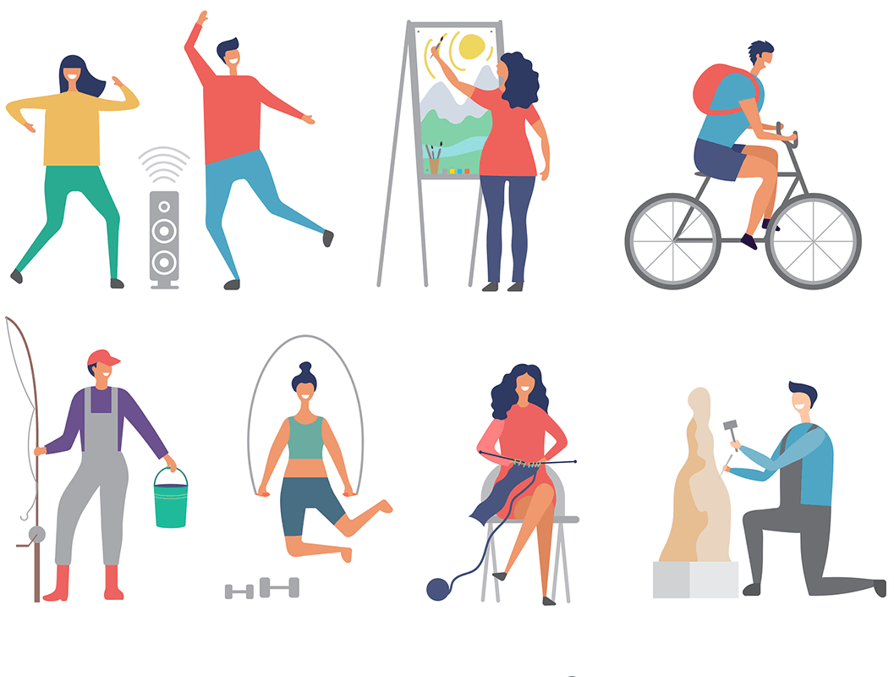
TALKING ABOUT YOUR HOBBIES
WHAT DO YOU ENJOY DOING?
Look at the picture and answer the questions:
1
What hobbies do you see in the image?
2
Do you have a hobby? What is it?
3
How often do you do your hobby?
4
What do you need for your hobby?
5
Have you ever tried a new hobby?

Slide 4
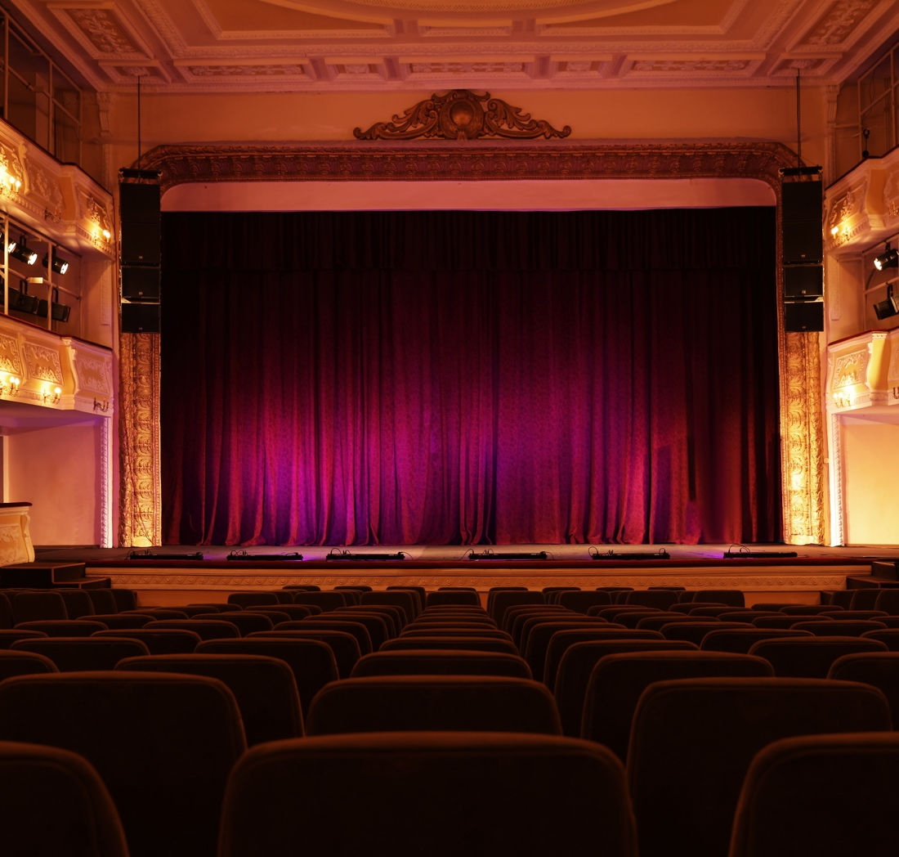
TALKING ABOUT YOUR HOBBIES
HOBBIES AND FREE TIME ACTIVITIES
Vocabulary List (From Document)
Theatre, Cinema, Museum, Concert, Gym, Band, To go jogging, To meet people, Comfortable, To get changed
Exercise: Complete the sentences with the correct words:
I go to the ________ to watch movies.
My favorite ________ plays rock music.
I like to ________ in the park every morning.
A ________ is a place where we can see plays.
I feel ________ when I wear sports clothes.

Slide 5
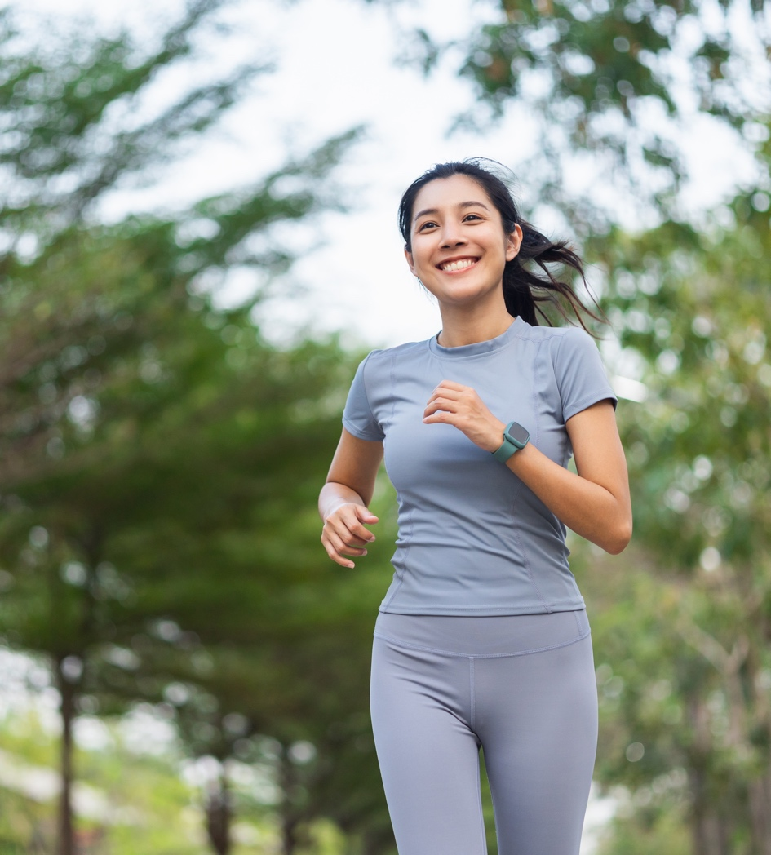
TALKING ABOUT YOUR HOBBIES
My Hobby Routine
Write 3 sentences about your hobby routine.
Example: I go running every morning. It makes me feel strong and happy.

Slide 6
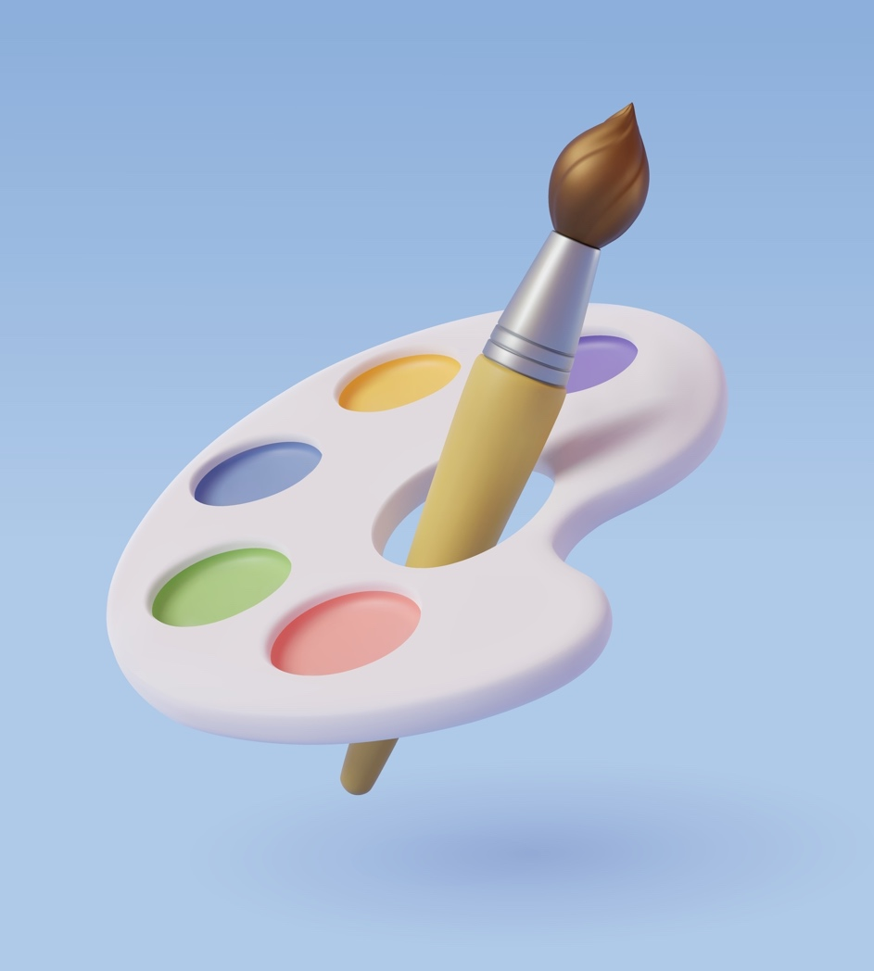
TALKING ABOUT YOUR HOBBIES
LET’S TALK ABOUT HOBBIES
Pair Work Exercise:
Step 1: Each student writes down two hobbies they like and one hobby they don’t like.
Step 2: In pairs, ask and answer questions like:
What’s your favorite hobby?
How often do you do it?
Why do you like it?
Do you prefer doing it alone or with others?

Slide 7
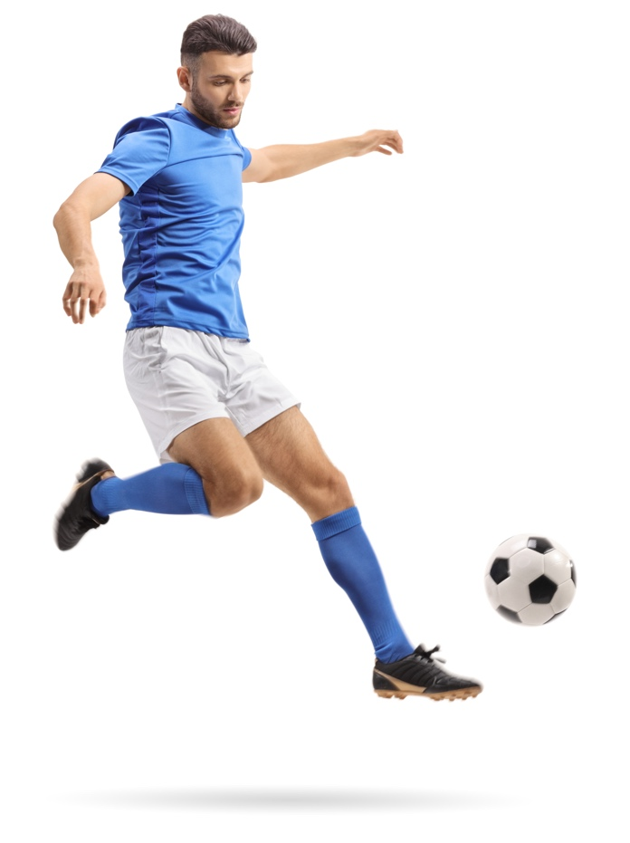
TALKING ABOUT YOUR HOBBIES
GRAMMAR IN ACTION – TALKING ABOUT HOBBIES
Expressing Likes and Interests:
I enjoy + (verb + -ing) → I enjoy painting landscapes.
I love + (verb + -ing) → I love playing soccer with my friends.
I’m interested in + (noun/verb + -ing) → I’m interested in photography.
Talking About Frequency:
I play chess once a week.
She goes jogging every morning.
They practice the guitar twice a month.
Complete the sentences with the correct structure:
I ______ (enjoy/love) ______ (hobby) on weekends.
She ______ (is interested in/enjoys) ______ (hobby) because it is fun.
We ______ (go/practice) ______ (hobby) every Saturday.
They ______ (play/do) ______ (hobby) twice a week.

Slide 8
TALKING ABOUT YOUR HOBBIES
VIRTUAL HOBBY CHAT
Think & Write (2 minutes): Each student writes three hobbies they enjoy in a shared document or chat. Example:
I like playing chess, painting, and hiking.
Ask & Answer (5 minutes): In pairs, students take turns asking and answering questions about their hobbies. Use these guiding questions:
What is your favorite hobby?
How often do you do it?
Do you prefer doing it alone or with friends? Why?
Report Back (3 minutes): Each student writes one sentence in the chat box summarizing their partner’s hobby. Example:
Maria likes painting. She started five years ago and prefers doing it alone.

Slide 9
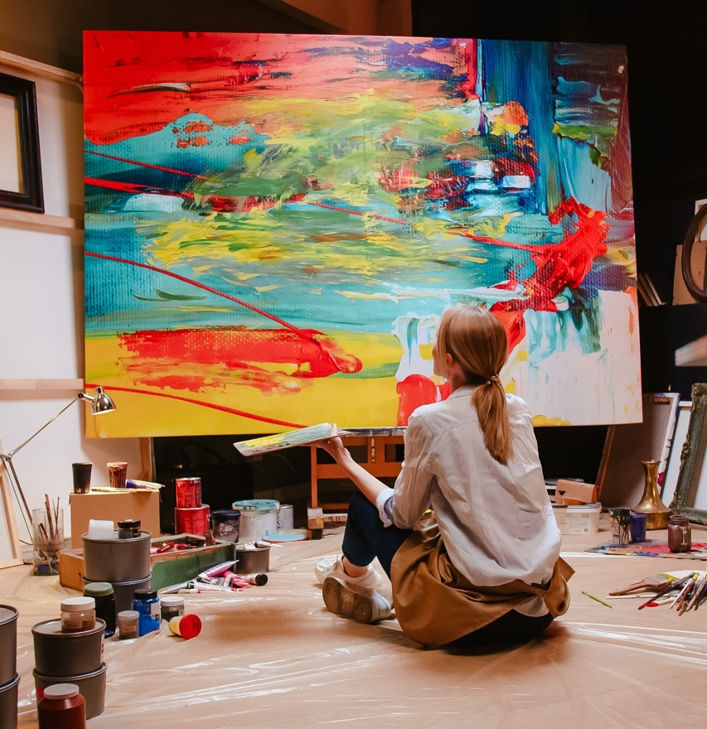
TALKING ABOUT YOUR HOBBIES
MY FAVORITE HOBBY
Task:
Write 3–4 sentences about your favorite hobby using the vocabulary from the lesson.
Example:
"I love painting. I paint every weekend in my free time. It is very relaxing."

Slide 10
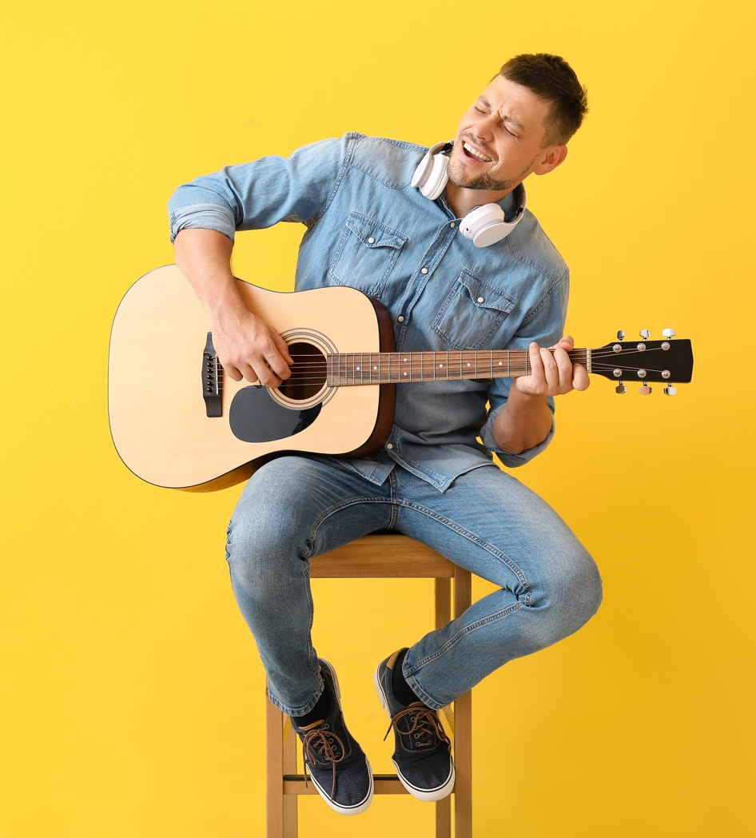
TALKING ABOUT YOUR HOBBIES
What’s your hobby?
Exercise: Fill in the blanks with the correct words:
My favorite hobby is ________.
I do it ________ times a week.
I need ________ to do my hobby.
I like it because ________.
I do my hobby with ________.

Slide 11
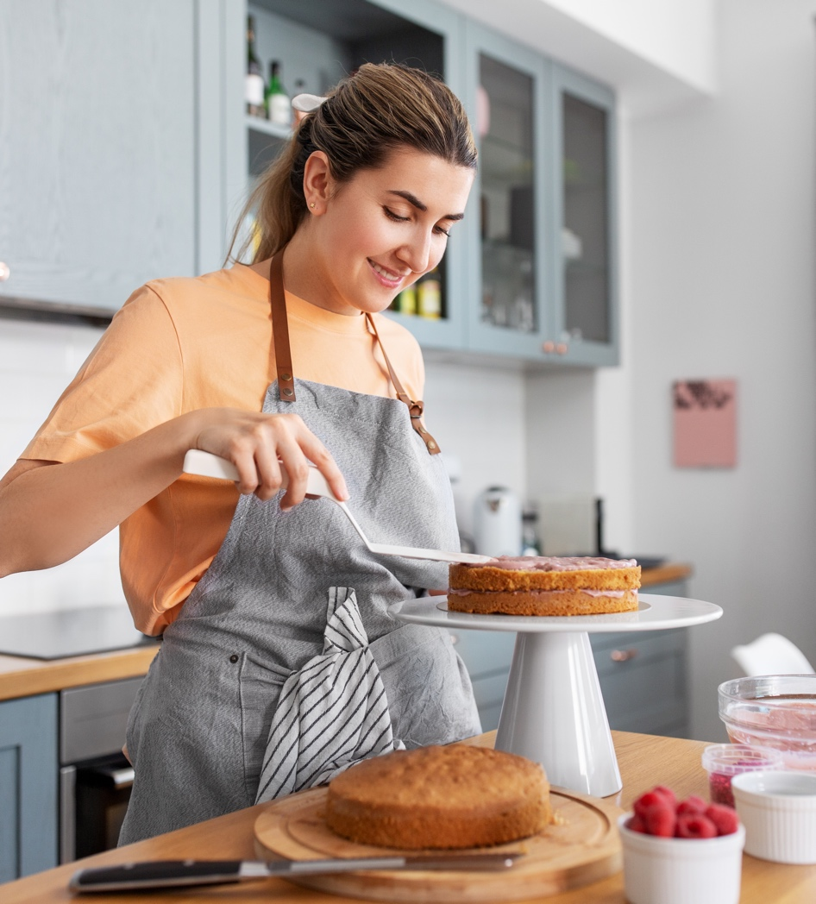
TALKING ABOUT YOUR HOBBIES
Check Your Learning
Answer these short questions to review today's lesson:
What is a hobby?
Can you name three hobbies?
How often do you do your favorite hobby?
What is a hobby you would like to try? Why?
Do you prefer indoor or outdoor hobbies?

